Slide 1
SQL Project – Superstore Data Analysis
Using SQL for Business Intelligence
Presented by Ritesh Nirmal

Slide 2
Introduction
- Superstore dataset simulates retail sales across products, customers, and regions.
- SQL used to analyze business trends and performance.
- Project Objective: Extract insights using SQL queries.

Slide 3
Dataset Overview
- Format: CSV file (Superstore.csv)
- Rows: 9,994 (approx.)
- Key Columns: Order_ID, Customer_Name, Sales, Profit, Region, Category
- Tool Used: MySQL (Workbench or Command Line)

Slide 4
Data Loading in SQL
1. Create table in MySQL using CREATE TABLE command.
2. Use LOAD DATA INFILE:
LOAD DATA INFILE '/path/to/Superstore.csv'
INTO TABLE superstore
FIELDS TERMINATED BY ',' ENCLOSED BY '"'
LINES TERMINATED BY '\n'
IGNORE 1 ROWS;

Slide 5
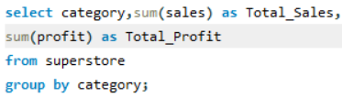
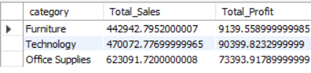
1.Total Sales and Profit by Category:
:
QUERY
OUTPUT
SELECT Category, SUM(Sales), SUM(Profit) FROM superstore GROUP BY Category;
- Top 5 Customers by Sales:
SELECT Customer_Name, SUM(Sales) FROM superstore GROUP BY Customer_Name ORDER BY SUM(Sales) DESC LIMIT 5;
- Most Sold Products:
SELECT Product_Name, SUM(Quantity) FROM superstore GROUP BY Product_Name ORDER BY SUM(Quantity) DESC;

Slide 6
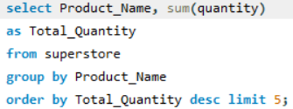
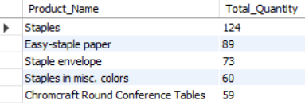
QUERY

Slide 7
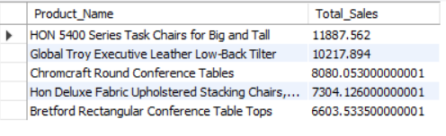
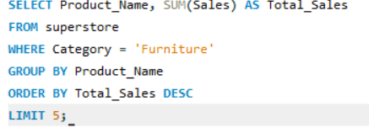

Slide 9
2. Most sold products by quantity
DGG

Slide 10
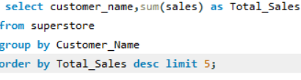
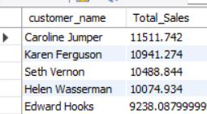

Slide 11
- Most Sold Products: SELECT Product_Name, SUM(Quantity) FROM superstore GROUP BY Product_Name ORDER BY SUM(Quantity) DESC

Slide 12
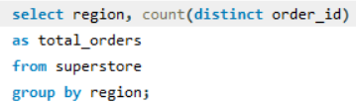
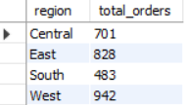

Slide 13
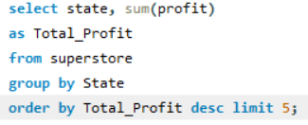
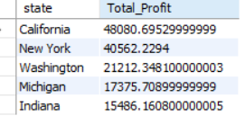

Slide 14
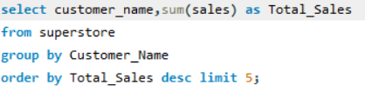
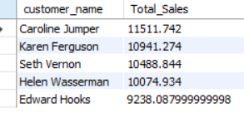
Top 5 Customers by Sales

Slide 15





Slide 16
Key SQL Queries (Part 2)
- Sub-Categories with High Sales but Loss:
SELECT Sub_Category, SUM(Sales), SUM(Profit) FROM superstore GROUP BY Sub_Category HAVING SUM(Sales) > 10000 AND SUM(Profit) < 0;
- Monthly Sales Trend for Central Region:
SELECT DATE_FORMAT(Order_Date, '%Y-%m') AS Month, SUM(Sales), SUM(Profit) FROM superstore WHERE Region = 'Central' GROUP BY Month;
- Ship Mode with Fastest Delivery:
SELECT Ship_Mode, AVG(DATEDIFF(Ship_Date, Order_Date)) FROM superstore GROUP BY Ship_Mode;

Slide 17
Advanced SQL Insights
- RFM Analysis:
SELECT Customer_ID, MAX(Order_Date), DATEDIFF(CURDATE(), MAX(Order_Date)) AS Recency,
COUNT(DISTINCT Order_ID) AS Frequency, SUM(Sales) AS Monetary FROM superstore GROUP BY Customer_ID;
- Cumulative Sales:
SELECT DATE_FORMAT(Order_Date, '%Y-%m') AS Month, SUM(Sales), SUM(SUM(Sales)) OVER (ORDER BY Month) AS Cumulative_Sales FROM superstore GROUP BY Month;
- Sales Contribution by Region:
SELECT Region, SUM(Sales) * 100 / (SELECT SUM(Sales) FROM superstore) AS Contribution FROM superstore GROUP BY Region;

Slide 18
Conclusion
- SQL helps extract actionable insights from Superstore dataset.
- Focus on top performing categories, customers, and regions.
- Optimize shipping methods and target high-value customers.
- Future Scope: Visualize with Power BI/Tableau.

